Slide 1
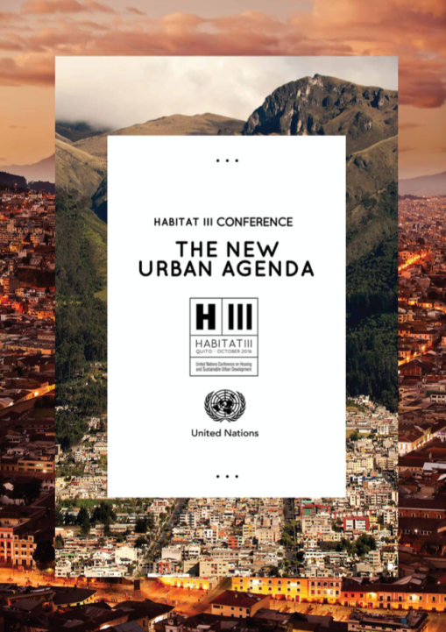


LA NUEVA AGENDA URBANA: contenido, contexto, aplicación
Rafael de Miguel González
VicePresidente de

Slide 2
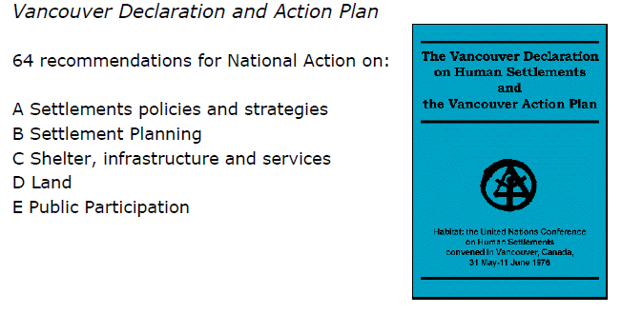

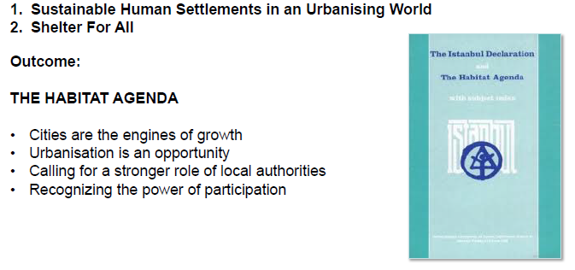

Habitat I – 1976
Vancouver
The international community began to recognize the need for sustainable human settlements and the consequences of rapid urbanization, especially in the developing world.
// Recognition that shelter and urbanization are global issues to be addressed collectively
// Vancouver Declaration and Action Plan
// Creation of the United Nations Center for Human Settlements (UNCHS-Habitat) - 1978
// Vancouver Declaration and Action Plan
The Vancouver commitments were reconfirmed The Vancouver commitments were reconfirmed 20 years later.
Adoption of the Habitat Agenda as a global plan of action for adequate shelter for all.
// Cities are the engines of global growth
// Call for a stronger role of local authorities
// Recognition of the power of participation
// The UNHCS becomes a Programme 2001
Habitat II – 1996
Istanbul
Habitat II – 1996
Istanbul

Slide 3
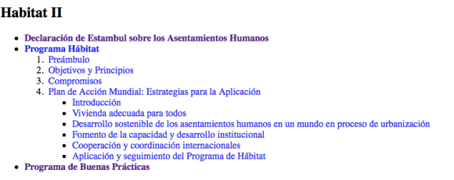
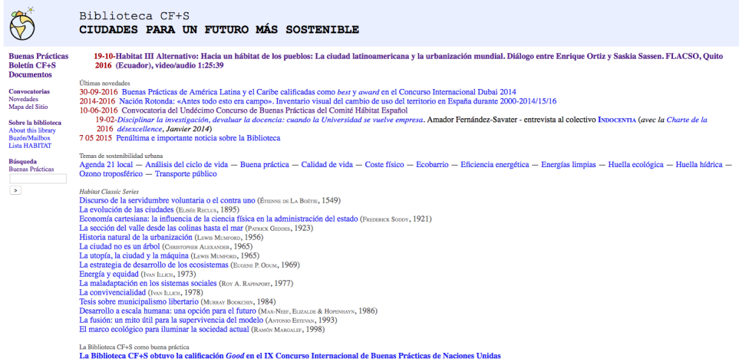

Slide 4
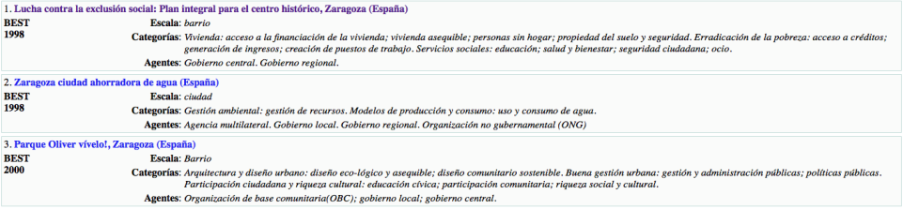

Slide 5
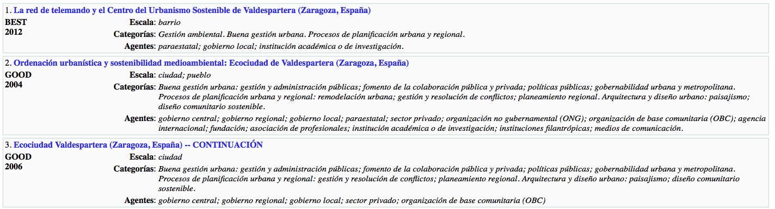
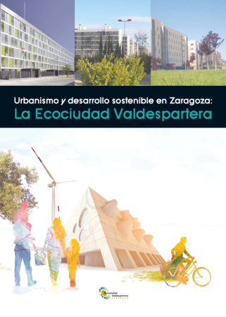

Slide 6

WHAT HAS CHANGED FROM 1996 – 4 MAJOR SHIFTS
STATE AND MAGNITUDE OF URBANIZATION
NEW SUBSTANTIVE FOCUSES IN THE GLOBAL AGENDA
HIGHER DEMAND OF PARTICIPATION
GROWING RECOGNITION OF URBANIZATION IN DEVELOPMENT FRAMEWORKS

Slide 7
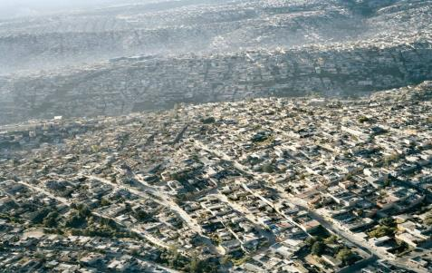
1. STATE OF THE URBANIZATION
World Urban Population
54.5%
Increasing Urban Sprawl
Economy (GDP) > 70%
Global energy cons. > 60%
Green gas emissions >70%
Global waste >70%
“Cities are where the battle for sustainable development will be won or lost”

Slide 8
Población y ciudades en España: informe nacional Habitat 2014
CUESTIONES Y DIFICULTADES DEMOGRÁFICAS URBANAS: HACIA UNA NUEVA AGENDA URBANA.
Introducción: Cuestión demográfica.
Proceso de urbanización acelerada.
Vinculación entre las zonas urbanas y las zonas rurales.
Atención a las necesidades de la juventud urbana.
Atender las necesidades de los mayores.
Integrar las cuestiones de género en el desarrollo urbano.
Dificultades y cuestiones futuras de demografía urbana que podrían tratarse a través de una Nueva Agenda Urbana.
ORDENACIÓN URBANA, MEDIOAMBIENTE, GOBERNANZA, ECONOMÍA, VIVIENDA, SERVICIOS

Slide 9
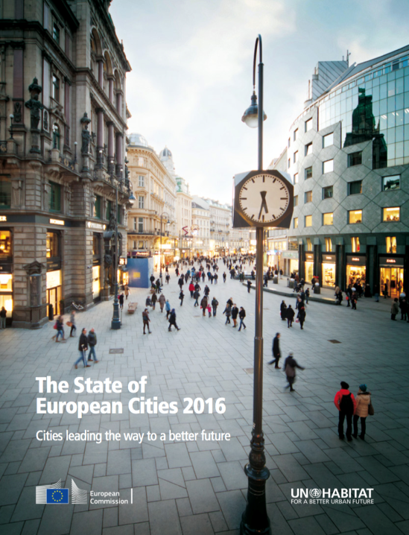

Slide 10
Demographic change
• The EU is urbanising but only slowly. Between 1961 and 1991, the population share of urban areas (cities, towns and suburbs) in the EU-28 increased from 65% to 71%. Between 1991 and 2011, however, this share grew by one percentage point to 72%.
• The population grew twice as fast in capital cities from 2002 to 2012 than in the EU as a whole. This high growth was due to a combination of positive net migration and high natural growth.
• Almost all capital cities have the highest share of foreign-born residents in the country. The share was over 20% in Brussels, London, Luxembourg, Paris, Stockholm and Vienna (2011 data for metro regions).
• The concentration of jobs and higher education institutes in cities attracts more working-age residents. In capitals, 62% of the residents are between 20 and 65, compared to 61% in other cities and 60% outside cities (2011 data for metro regions).
• Cities need to think how to accommodate a growing elderly population. Cities can facilitate active ageing by ensuring that public spaces, transport and buildings are accessible for people with limited mobility.

Slide 11
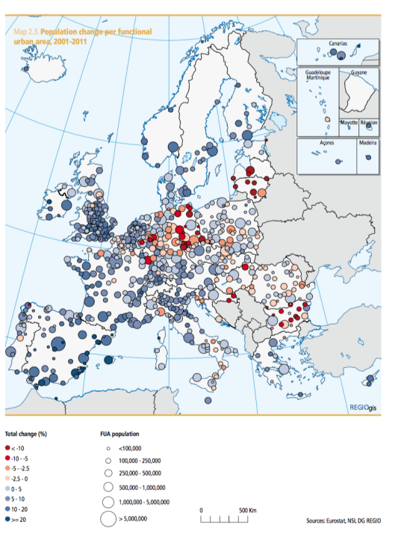

Slide 12
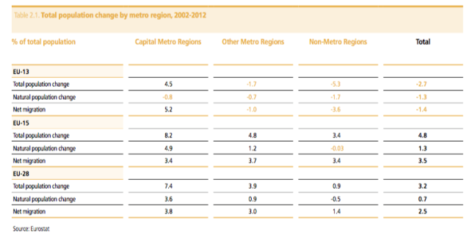
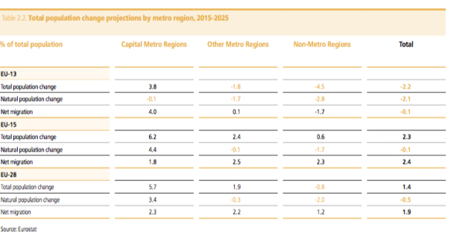

Slide 13
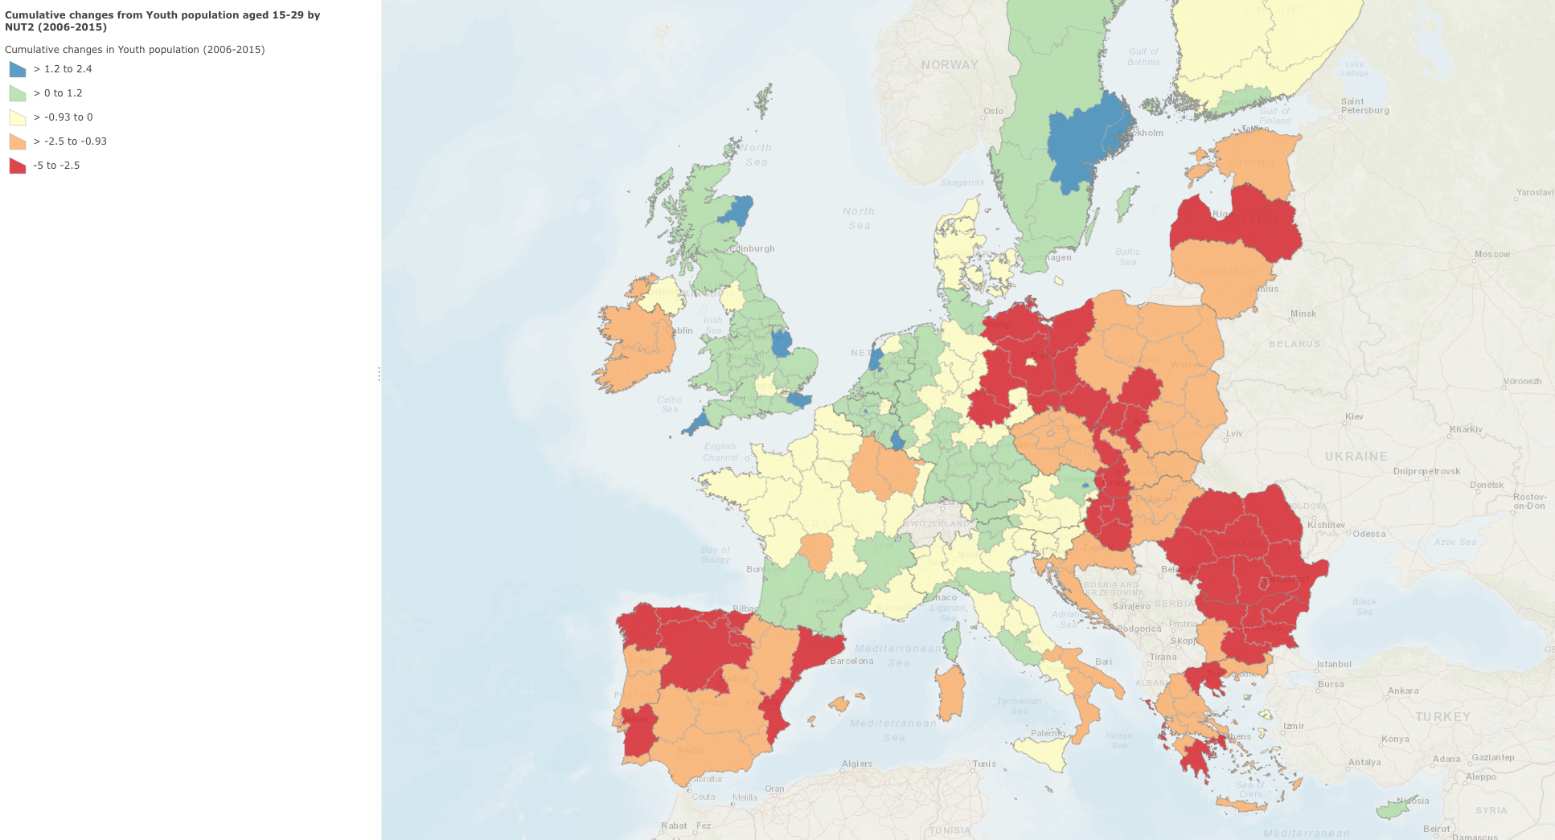

Slide 14
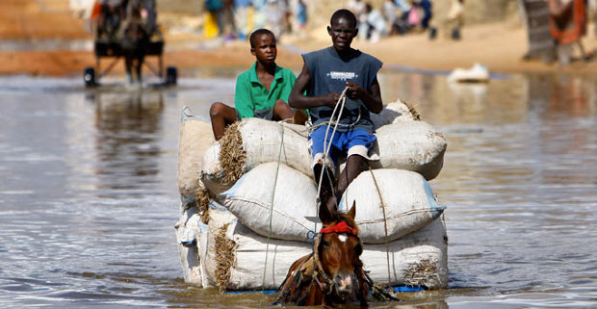

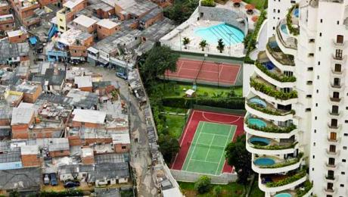
2. GLOBAL AGENDA NEW FOCUSES
New challenges to address in the Global Agenda - spatially manifested in urban settings
Vulnerability and risks to natural and man-made hazards – Climate change
Economic crises, unemployment and insecurity
Growing inequalities
Environmental crises, air/water pollution, loss of agri-land and biodiversity
CLIMATE CHANGE
PEACE AND SECURITY
INEQUALITY
It is becoming more and more clear that achievements on Sustainable development will depend on how we will manage and guide the urbanization

Slide 15
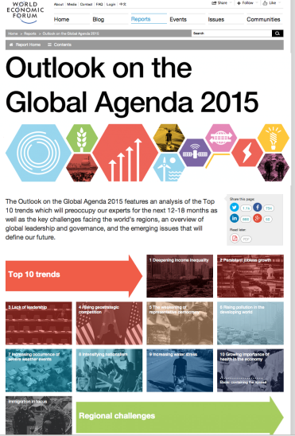

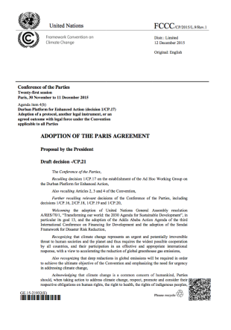

Slide 16
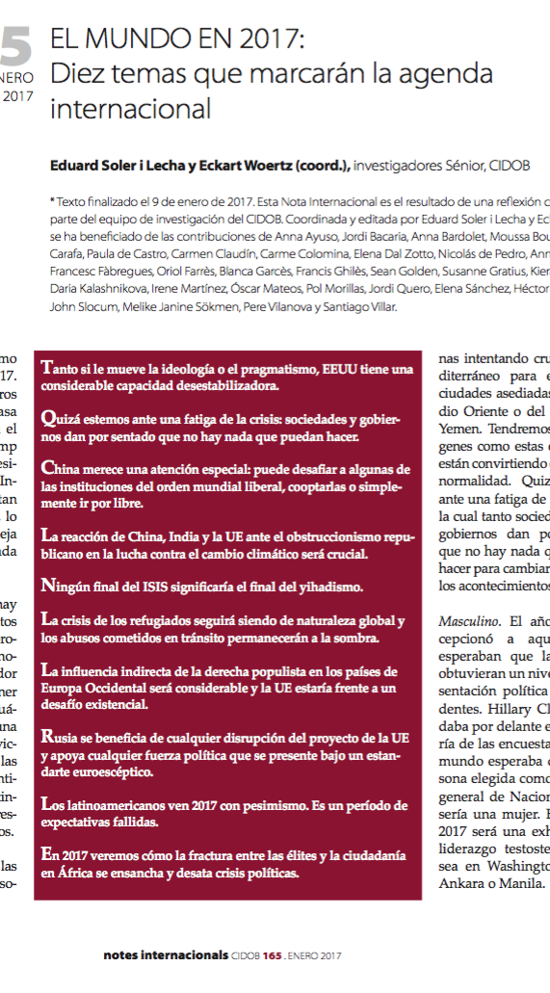
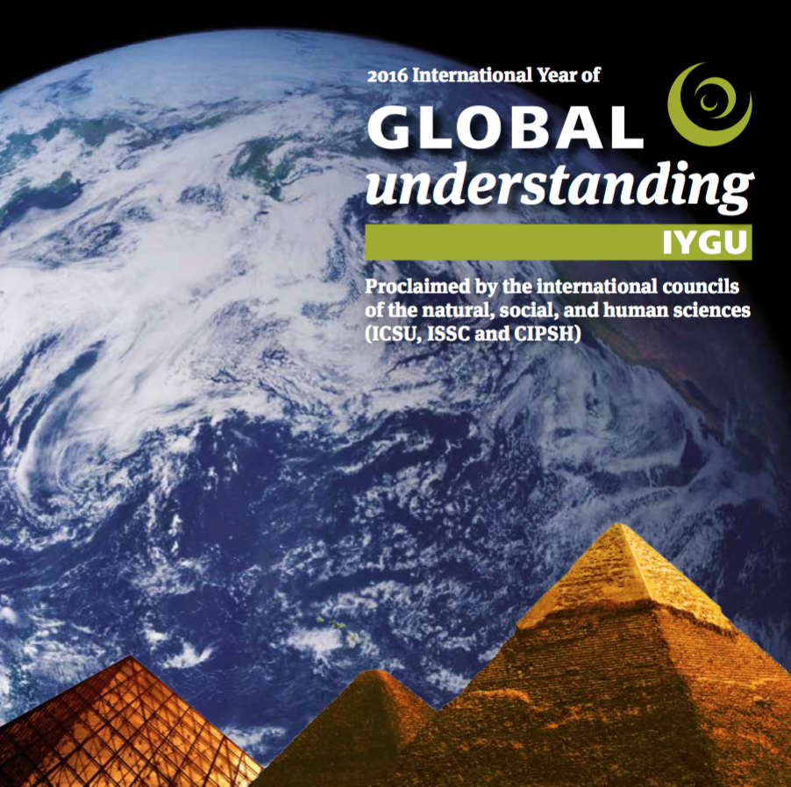



Slide 17
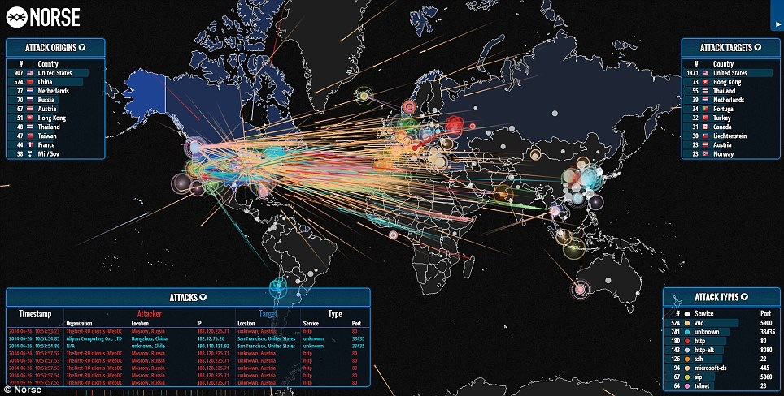

Slide 18
3. DEMAND OF PARTICIPATION
To address the demand of participation to ensure sustainability
Habitat II as one of the first inclusive UN conference in the 90’s and creation of the “Habitat Agenda Partners”
Expansion of ICT facilitating and also fuelling the society demand of participation
Need to address the growing skepticism towards international summits

Slide 19
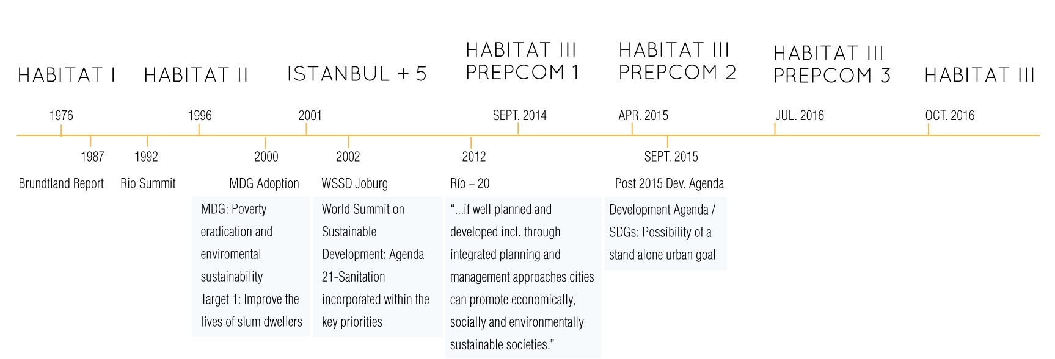
4. GLOBAL DEVELOPMENT FRAMEWORKS
Growing recognition of urbanization reflected in global frameworks for sustainable development

Slide 20
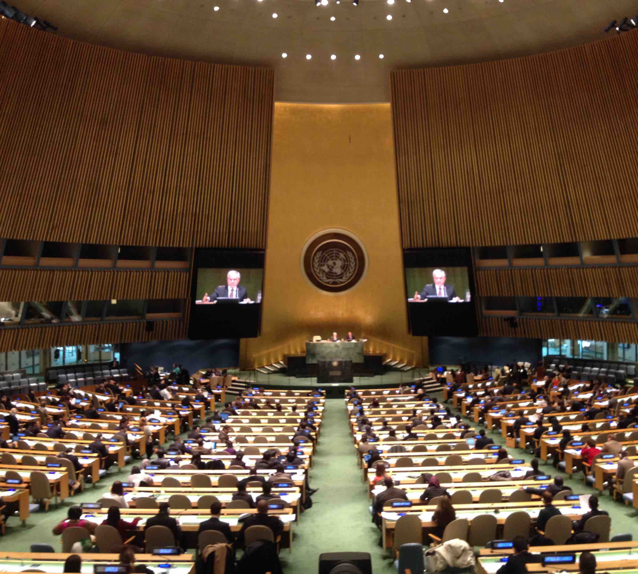
United Nations Conference on Housing and Sustainable Urban Development
(Habitat III)
GA res. 66/207 in 2011 the United Nations General Assembly decided to convene the Habitat III Conference in line with bi-decennial cycle (1976, 1996 and 2016),
GA Res. 67/216 in 2012, decided the objective of the conference:
- To secure renewed political commitment
for sustainable urban development,
- To assess HA accomplishments to date,
addressing poverty,
- To identify and address new and
emerging challenges.
GA Res. 69/226 in 2014, decided that the Conference will be held in Quito in October 2016.

Slide 21
HABITAT 3, RETO PRINCIPAL:
LA SOSTENIBILIDAD DEL PLANETA
1976: 38% (1.520 M DE 4.000 M)
1996: 45% (2.529 M DE 5.600 M)
2016: 55% (4.015 M DE 7.300 M)
2036: 66% (5.610 M DE 8.500 M)
2050: 70% (6.790 M DE 9.700 M)

Slide 22
HABITAT 3, RETO PRINCIPAL:
LA SOSTENIBILIDAD DEL PLANETA
2016: 55% (4.015 M DE 7.300 M)
2% tierras emergidas
60 % consumo energía
70 % PIB mundial
70 % emisiones CO2, residuos
Para 2036: entre 75-80%

Slide 23
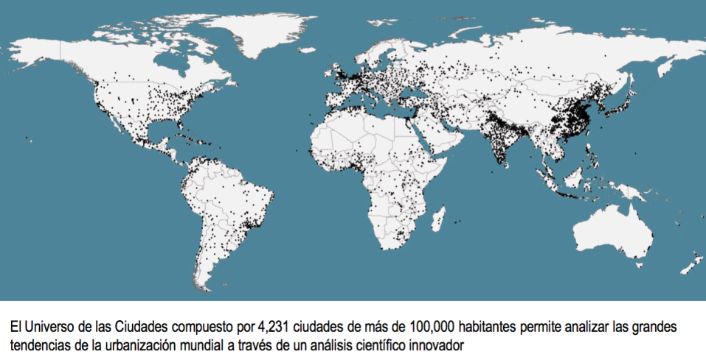

Slide 24
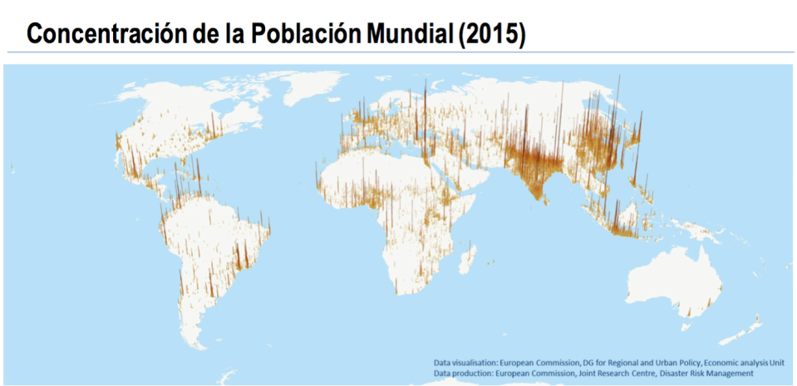

Slide 25
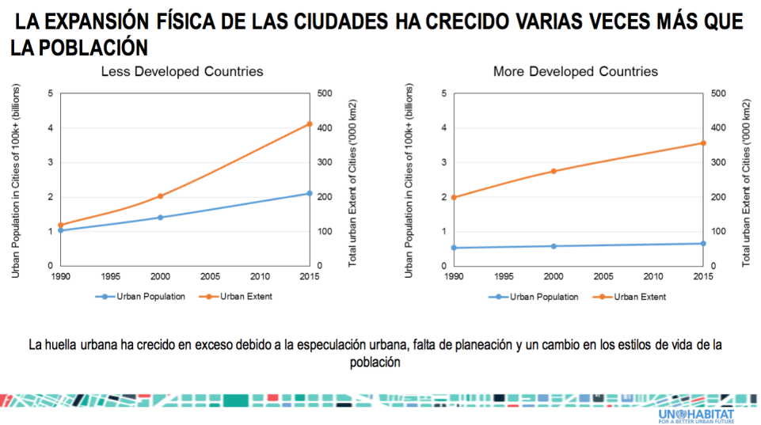

Slide 26
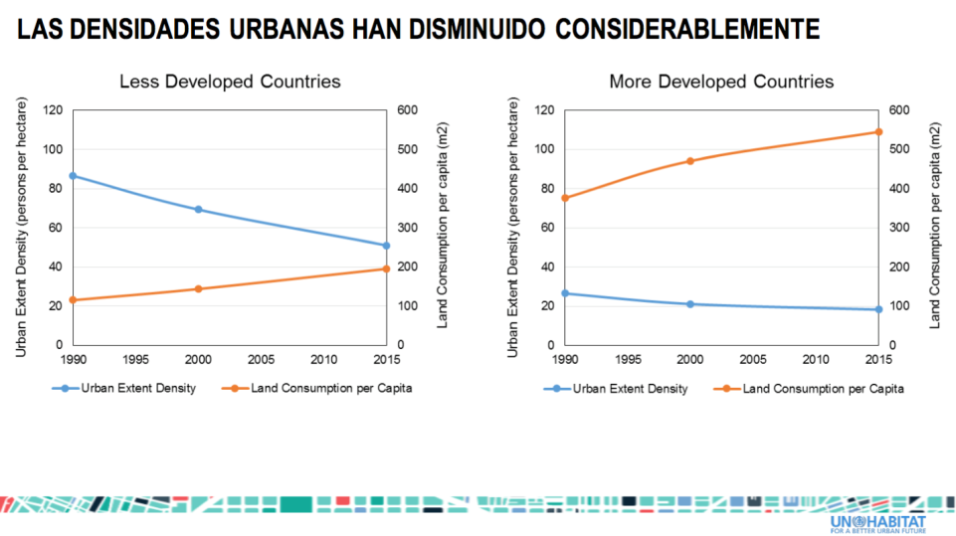

Slide 27
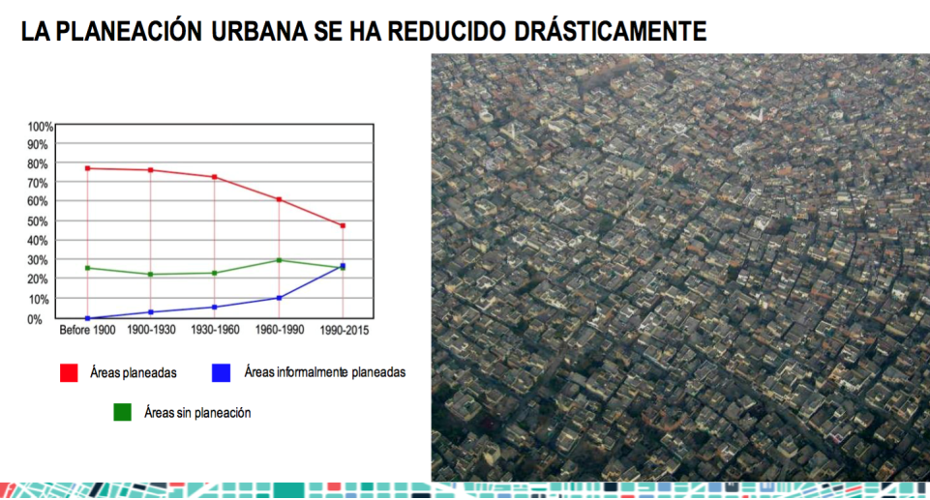

Slide 28
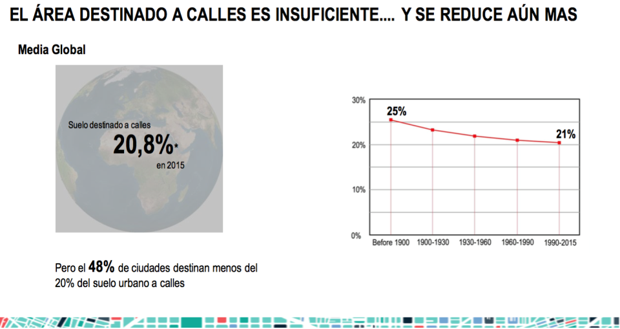

Slide 29
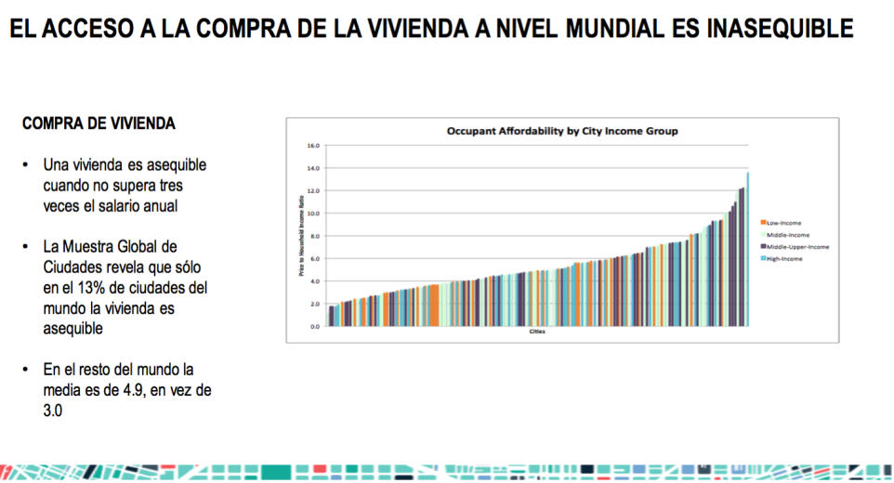

Slide 30
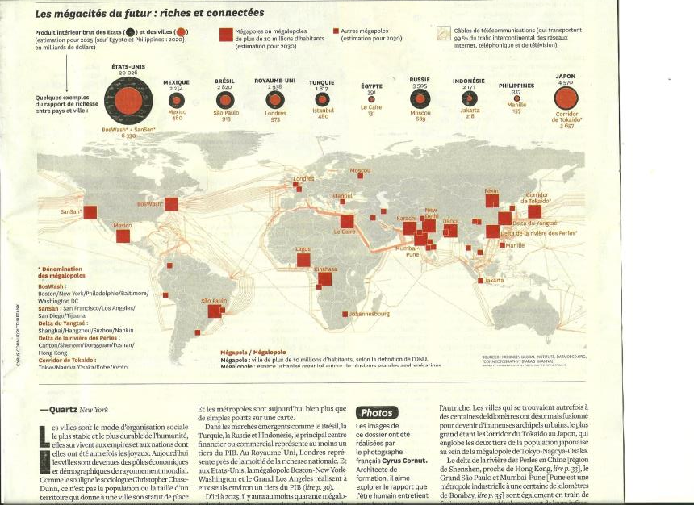

Slide 31
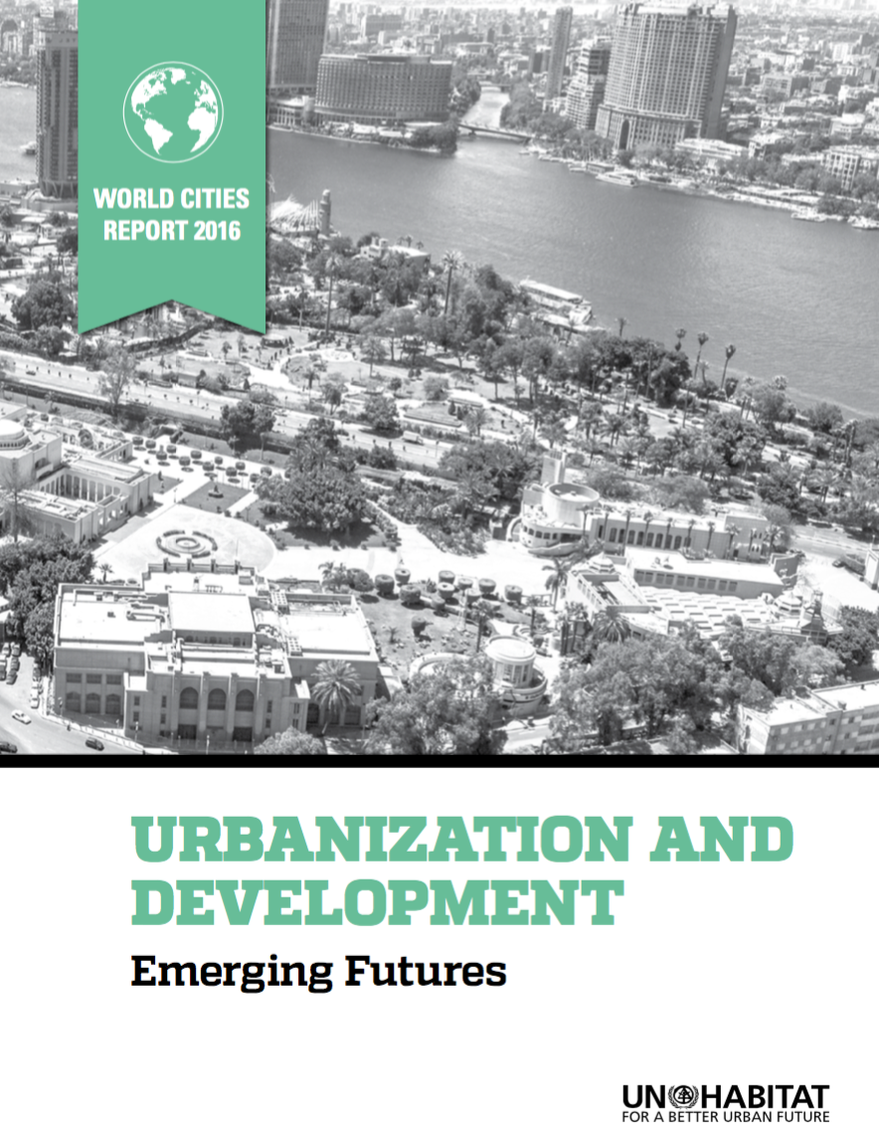

Slide 32
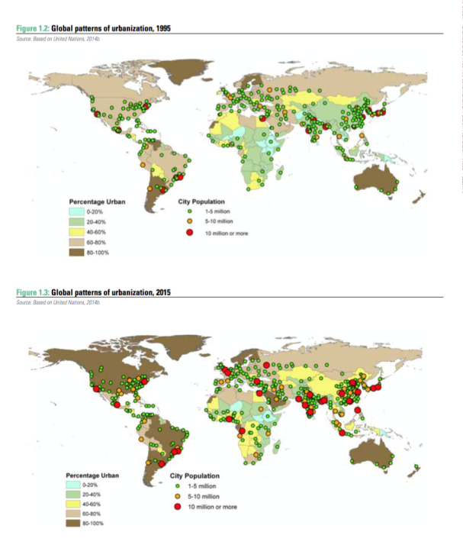

Slide 33
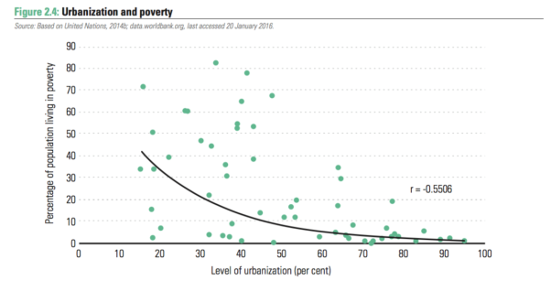

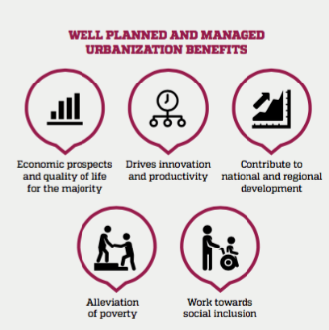
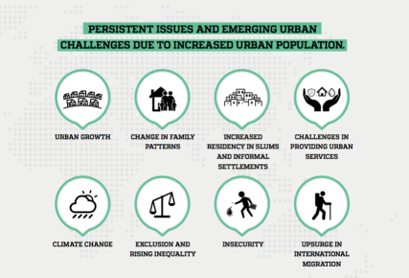

Slide 34
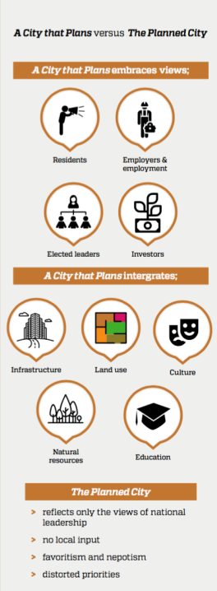
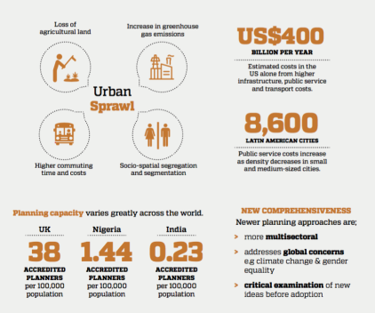
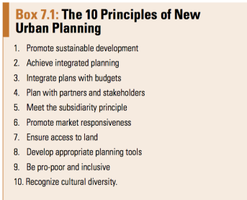

Slide 35
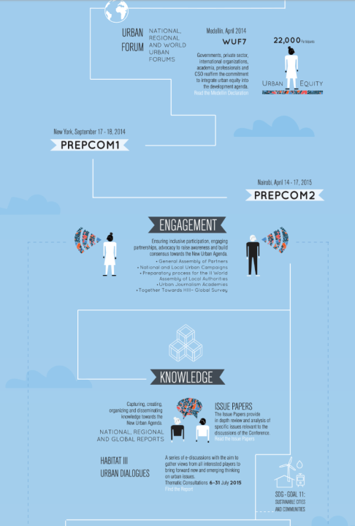
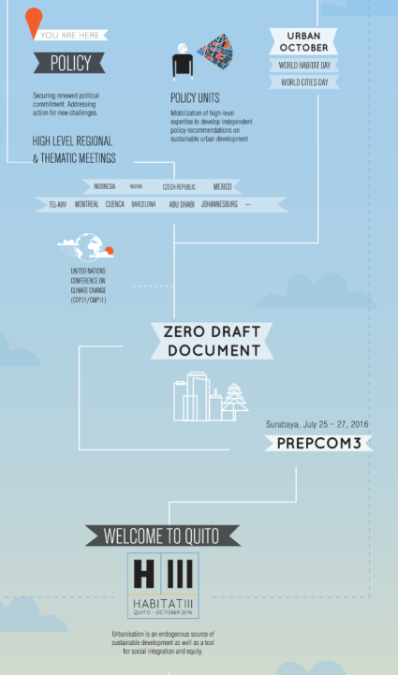

Slide 36
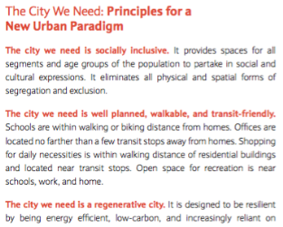
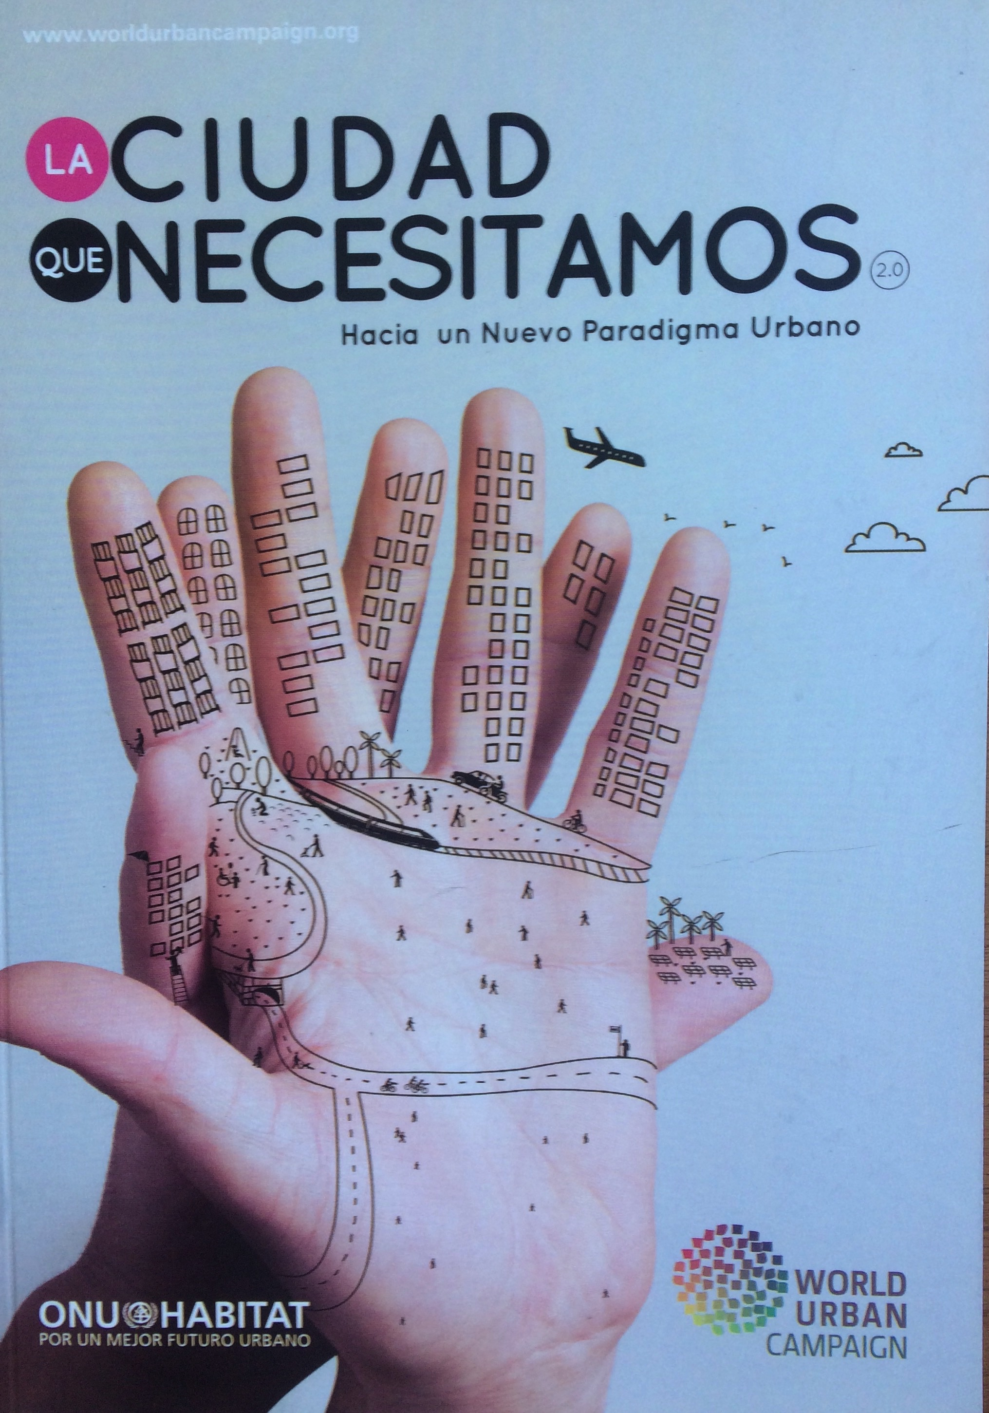
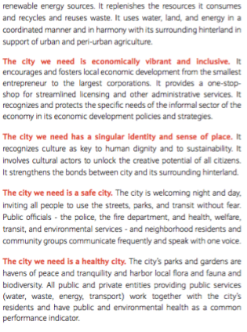
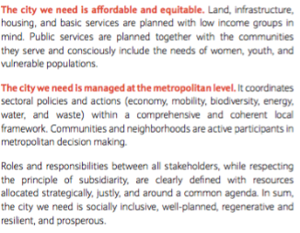

Slide 37
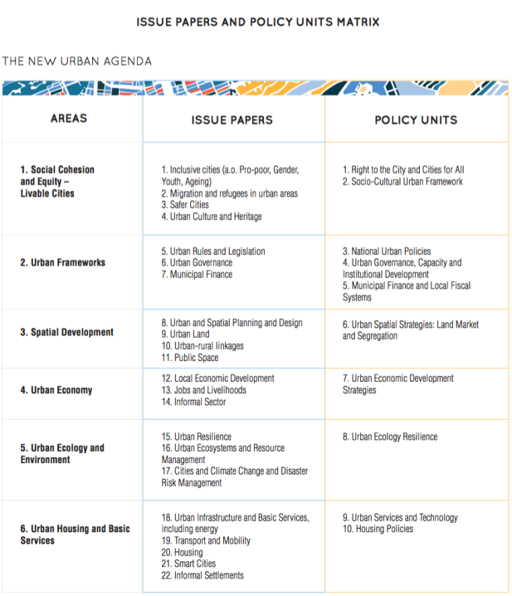
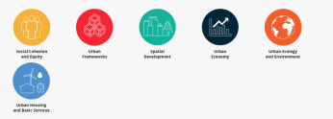

Slide 38
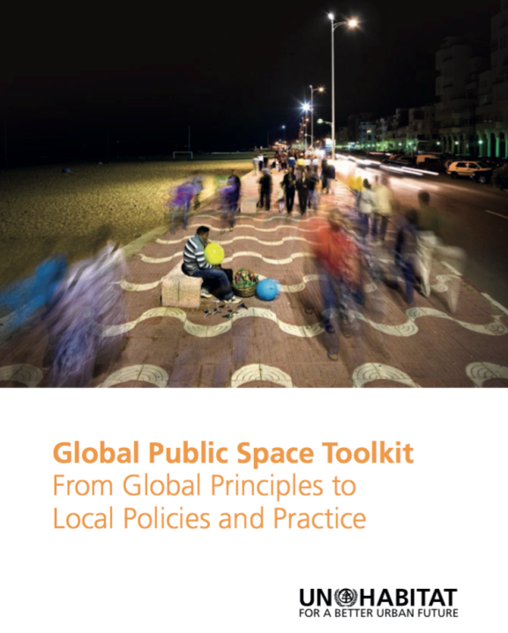
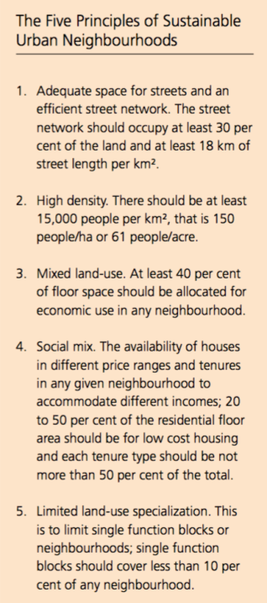

Slide 39
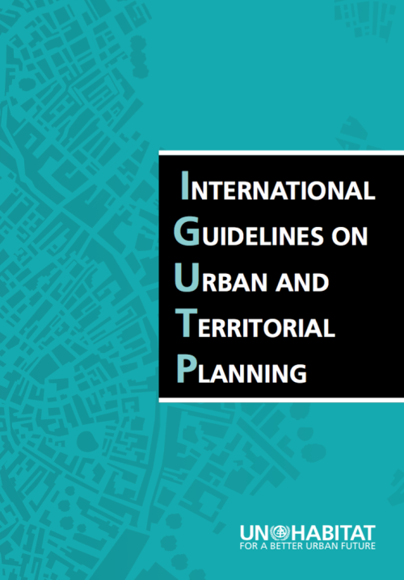

Slide 40





AGENTES INTERVINIENTES NUA
Estados miembros ONU
ONU: Secretariado Habitat III (Prepcom)
General Assembly of Partners

Slide 41


Slide 42


Slide 43



Slide 44







Slide 45



Slide 46





Slide 47





Slide 48




Slide 49
175 apartados
Introducción
  Reto: sostenibilidad del planeta (social, económica, ambiental) en términos de vivienda, empleo, infraestructuras y servicios básicos, educación, sanidad, agua y alimento, recursos naturales y energéticos, seguridad
  Utopía del fin de la pobreza, del hambre, de las desigualdades
  Cambio climático: Acuerdo de París y ODS 2015-2030
  Ciudades para todos, inclusión, cohesión social.
  Derechos humanos (ONU, 1948)= derechos urbanos: igualdad de derechos y oportunidades, acceso universal a unos mínimos estándares de vida.
3 principios esenciales
  Desarrollo urbano sostenible para la inclusión social y la erradicación de la pobreza
  Prosperidad urbana sostenible. Oportunidades para todos
  Desarrollo urbano ambientalmente sostenible y resiliente
Implementación efectiva de la NAU
  Construyendo la estructura de gobernanza urbana y el marco institucional de apoyo
  Planificando y gestionando el desarrollo espacial
  Medios de implementación: ONU y organismos internacionales, nacionales, regionales y locales; agentes diversos, sector privado, sociedad civil (partners), cooperación internacional, organismos financieros de inversión.

Slide 50
  Desarrollo urbano sostenible para la inclusión social y la erradicación de la pobreza
    Slums, asentamientos informales
    Vivienda, desahucios
    Agua corriente y saneamiento; servicios básicos
    Seguridad y violencia
    Género, edad
  Prosperidad urbana sostenible. Oportunidades para todos
    Economías de escala: infill urban extension, urban renewal
    Eficiencia en las infraestructuras transporte
    Business environment
    Emprendimiento – economía informal
    Economía urbana alto valor añadido: tech, cultura, creative, turismo, patrimonio.
  Desarrollo urbano ambientalmente sostenible y resiliente
    Cambio climático: emisiones atmósfera; 3 R
    Smart cities
    Espacios libres y espacios públicos
    Catástrofes

Slide 51
Implementación efectiva de la NAU
  Construyendo la estructura de gobernanza urbana y el marco institucional de apoyo: metrop-megalop
  Planificando y gestionando el desarrollo espacial
    Planeamiento flexible short/long term
    Transición periurbana
    Renewal, regeneration, retrofittiting
    Compacidad, densidad, conectividad (mono/policentr.)
    Best possible commercial use of street-level floors, peatonalización,
    Registro propiedad, catastro, información urbanística
    Cuadros de mando: monitorización
    Diseño urbano y seguridad vial (transporte escolar); intermod.
    TOD
    Eficiencia energética edificios
    Recuperación de plusvalías (Value capture)
    Marcos jurídicos y normativos

Slide 52





Slide 53





Slide 54
  Medios de implementación NAU:
  agencias ONU
  gobiernos nacionales, locales y regionales
  proyectos cooperación internacional
  programas sectoriales
  Empresas
  Stakeholders, GAP, WUC

Slide 55


Slide 56



Slide 57




Slide 58



Slide 59

Muchas gracias
rafaelmg@unizar.es

