Slide 1
Rights in urban development: rights and duties
c
Coordinator, Legislation, Land and Governance
Robert.Lewis-Lettington@unhabitat.org
Notes:
1
WONDERING WHAT ANGLE TO TAKE IN CONTEXT OF PREVIOUS PRESENTATIONS. HAVE DECIDED TO FOCUS ON WHAT RIGHTS AND DUTIES MEAN IN THE CONTEXT OF UN-HABITAT’S PLAN TO IMPLEMENT THE NEW URBAN AGENDA.

Slide 2
There are no rights and duties without law
Notes:
RIGHTS AND DUTIES ARE DEFINED IN LEGAL TERMS. THEY ARE NOT NEGOTIABLE.

Slide 3
Without good quality law rights and duties mean very little
Notes:
IF THE LAW IS AMBIGUOUS, UNENFORCEABLE OR OTHERWISE INADEQUATE, RIGHTS AND DUTIES ARE EMPTY. INFORMATION AND POWER EQUAL RIGHTS IN THE ABSENCE OF LAW.

Slide 4
A good quality law is defined by whether:
Its intentions are reasonably clear, well understood and widely accepted
It is meeting its objectives and achieving the broadly expected impact
It is the most efficient means of achieving the expected impact
Success or failure, or a ‘good’ or a ‘bad’ law, should be determined by how effective it is in delivering its identified function: functional effectiveness
Notes:
LAW MUST REST ON AN UNDERSTANDING OF POLICY, HOWEVER OLD OR BASIC THAT POLICY MAY BE. LAW MUST ALSO BE ASSESSED AND JUDGED – IT SERVES PEOPLE, NOT THE OTHER WAY AROUND.

Slide 5
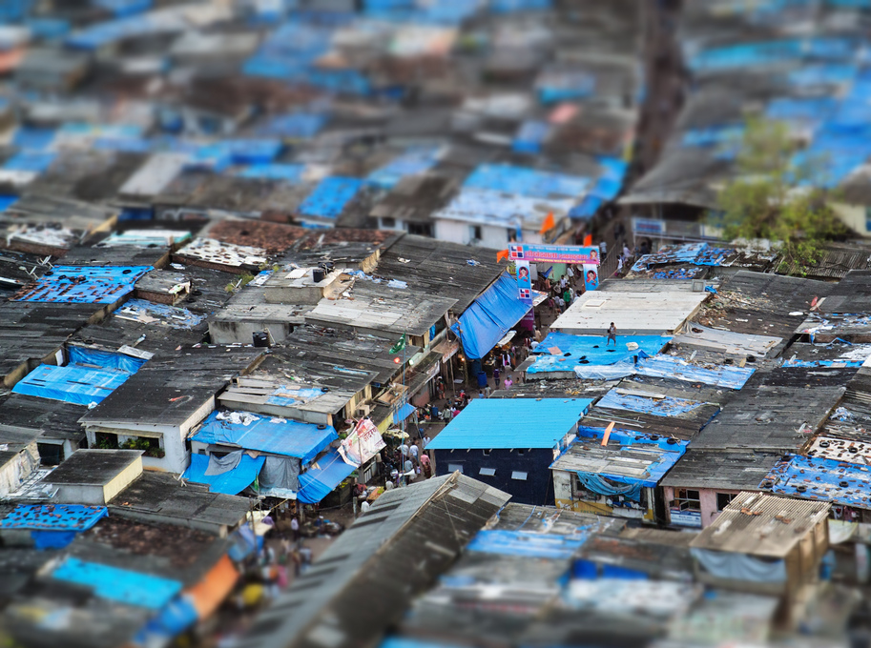
Clear language – lucid, rational language – to a man at war with both truth and reason, is an existential threat. Clear language to such a man is a direct assault on his obfuscations, contradictions and lies … he knows, if only intuitively, what we know to our cost: that without clear language, there is no standard of truth.
- John le Carre, The Guardian. 1st July 2017.
Notes:
POOR QUALITY LAW AND POLICY, BOTH IN QUANTITY AND CONTENT, CAN EASILY BE ABUSED AND WILL UNDERMINE THE RIGHTS AND INTERESTS OF THE POOR AND VULNERABLE.

Slide 6
Action Framework for the Implementation of the New Urban Agenda
Systems (4 elements)
2. Codes (5 elements)
Notes:
Urban Systems are more related to governance, institutions and processes that govern the management of urbanization. While urban codes are related to the Rules on how specific technical standards and issues are are addressed and designed.

Slide 7
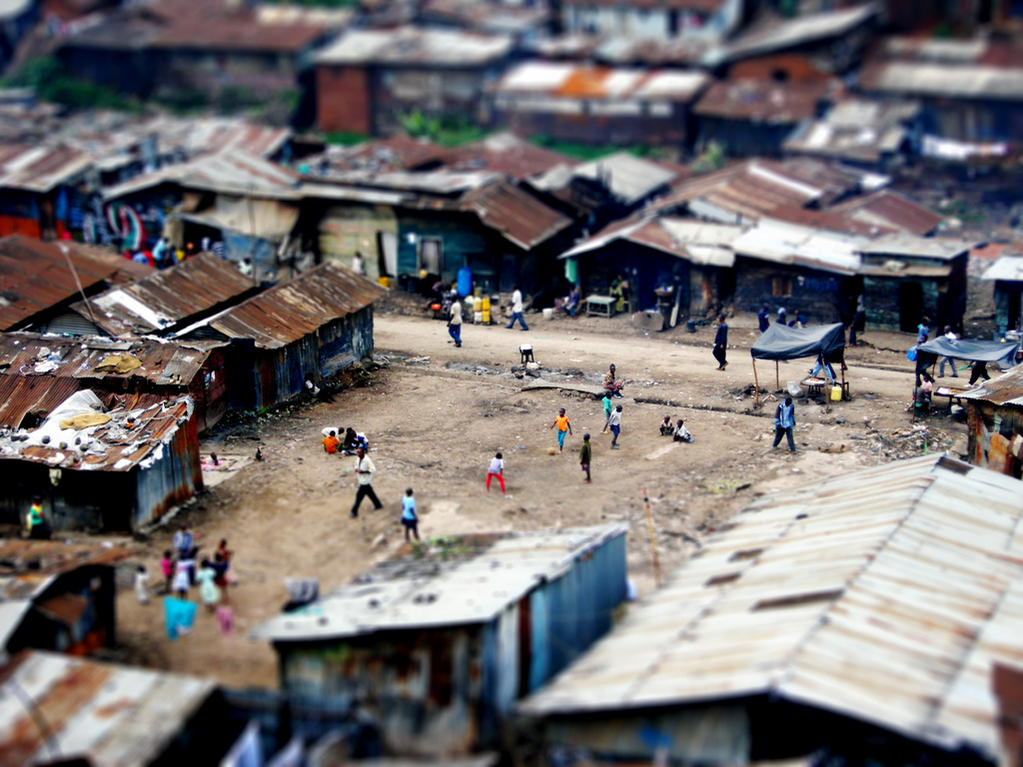
Urban systems
Define urban land vis-à-vis non-urban land as well as the rights and responsibilities inherent to urban land
Notes:
Establishing an effective and equitable legal basis for integrated urban and territorial planning and development and land management, including cataloguing urban vis-à-vis non-urban (i.e. agrarian, forested, environmentally-protected, etc) land
RIGHTS: I) BASIC QUESTION OF RIGHT TO SHELTER – IF AMOUNT OF LAND FOR URBANISATION IS NOT PROPORTIONATE TO NEED, WILL VIOLATE RIGHT.
DUTIES: I) MAKE THE DEFINITION CLEAR; 2) MAKE THE PROCESS OF DEFINITION FAIR AND TRANSPARENT AND PROVIDE FOR THE PUBLIC GOOD; PROVIDE FOR A CLEAR SYSTEM OF GOVERNANCE

Slide 8
Urban systems
2. Adopt an effective legal framework that supports strengthening the capacity of national, subnational and local governments and ensures appropriate fiscal, political and administrative decentralization based on the principle of subsidiarity
Notes:
Supporting local governments in determining their own administrative and management structures Legal and accountable basis for functional and fiscal devolution to sub-national and local governments according to national policy. This must link powers and responsibilities to policy objectives and adequate resources.
RIGHTS: 1) ACCOUNTABILITY FOR SERVICE DELIVERY; 2) LOCAL PRIORITIES WITHIN A NATIONAL FRAMEWORK
DUTIES: 1) REVENUE AND SERVICE CORRELATION WITHIN SCOPE OF POSSIBLE REDISTRIBUTION; 2) EQUITABLE SERVICE DELIVERY

Slide 9
Urban systems
3. Develop equitable and legal instruments to capture and share the increase in land and property value generated as a result of urban development processes, infrastructure projects and public investments, ensuring that these do not result in unsustainable land use and consumption.
Notes:
Capturing and sharing the increase in land and property value generated as a result of urban development processes, infrastructure projects and public investments. Gains-related fiscal policies can be adopted to prevent solely private capture, land and real estate speculation. Ultimately the generation of land-based finance must not result in unsustainable land use and consumption patterns.
RIGHTS: PUBLIC INTEREST IN DEVELOPMENT GAINS
DUTIES: EQUITABLE AND ACCOUNTABLE USE OF REVENUE

Slide 10
Urban systems
4. Establish impact assessment, monitoring, inspection, correction and enforcement tools
Notes:
Design of systems is paramount—systems should be designed to be enforceable from the outset, rather than after the fact. But correction and enforcement are not solely coercive. Police powers, to the extent that they should be used at all, should play a secondary role in enforcement.
RIGHTS: ACCOUNTABILITY AND EFFICIENCY
DUTIES: COMPLIANCE

Slide 11
Urban codes
5. Establish a legal basis for the urban plan and distinguish public space from buildable urban land
Notes:
Ensuring that urbanization is guided by the rule of law requires that the urban plan is a formal legal instrument enforceable against all within the jurisdiction and accountable to citizens (particularly in terms of modification and conflict resolution). At the national and provincial level, linking land use, administrative bodies and planning to define urban areas according to reasonable growth projections. At the local level, linking planning, land use and development control to delineate buildable/non-buildable land, such as environmental management areas.
RIGHTS: 1) TRANSPARENCY AND ACCOUNTABILITY IN DECISION MAKING; 2) ACCESS TO PUBLIC SPACE; 3) QUALITY AND RELEVANCE OF PUBLIC SPACE.
DUTIES: 1) MAINTENANCE OF PUBLIC SPACE; 2) COMPLIANCE WITH PLAN AND ASSOCIATED PROCESSES

Slide 12
Urban codes
6. Enact effective law for the definition, acquisition and protection of public space
Notes:
Public space, including green space, roads, streets and intersections, transport rights-of-way and other corridors, is central to livability, efficiency and equity in urban areas. It must be adequately provided for but not rely exclusively on expropriation for its acquisition —rather also on tools such as land readjustment. Clear public space protection responsibilities must also be established.
RIGHTS: 1) NOT TO BE ARBITRARILY DEPRIVED OF PROPERTY; 2) ACCESS TO QUALITY PUBLIC SPACE
DUTIES: 1) PUBLIC SPACE WILL BE ACQUIRED IN THE PUBLIC INTEREST; 2) PUBLIC SPACE WILL BE EQUITABLY MAINTAINED

Slide 13
Urban codes
7. Recognize and regulate urban development, i.e. buildability rights
Notes:
The area and proportion of a plot that may be built upon and the permitted building height and floor space are fundamental to value and have a significant impact on street dynamics and service demands. These elements should be effectively regulated and actively managed to fairly balance burdens and benefits.
RIGHTS: 1) REASONABLE OPPORTUNITY TO EXPLOIT PROPERTY RIGHTS; 2) RIGHT TO A HEALTHY URBAN ENVIRONMENT
DUTIES: 1) EFFECTIVE MANAGEMENT IN THE PUBLIC INTEREST; 2) PROPORTIONALITY BETWEEN DEVELOPMENT RIGHTS AND SERVICE PROVISION AND PUBLIC SPACE

Slide 14
Urban codes
8. Develop inclusive, adequate and enforceable regulations in the housing and economic sectors, including resilient building codes, standards, development permits, land use by-laws and ordinances, and planning regulations, combating and preventing speculation, displacement, homelessness and arbitrary forced evictions
Notes:
Housing and building codes can have fundamental impacts on street dynamics and urban equity, as well as their more traditional role in risk management. Inappropriate codes may be exclusionary, encourage informality and undermine the rule of law. Codes must balance their various impacts to maximize their effectiveness and, where necessary, they should recognize the varying contexts that may exist within a jurisdiction. The overall aim is to ensure sustainability, quality, affordability, health, safety, accessibility, energy and resource efficiency and resilience.
RIGHTS: 1) ADEQUACY OF SHELTER; 2) ACCESS TO SHELTER; 3) SECURITY OF TENURE
DUTIES: 1) HEALTH AND SAFETY; 2) UNIVERSAL PROVISION

Slide 15
Urban codes
9. Establish national minimum standards for universal access to basic services reflecting the right to an adequate livelihood and above and beyond these minimum standards allowing for subnational variation according to need and situation
Notes:
Law must clearly support basic services policy and be regularly scrutinized. Benchmarks should be based on equitable access to water, public transport, energy, waste management, digital infrastructure and ICT.
RIGHTS: 1) UNIVERSAL RIGHTS TO BASIC SERVICES; 2) NATIONAL DIVERSITY
DUTIES: 1) ACCESS AND AFFORDABILITY; 2) QUALITY

Slide 16
Thank you
Robert.Lewis-Lettington@unhabitat.org
@LewisLUNHabitat
Notes:
16

